Slide 1

Prospect Nurture and Witness

Slide 2

What gets in the way of sharing God’s Word with people?
No new
Messes!
Prioritizing
SIN
Time
Management

Slide 3
THE FUNNEL PLAN FOR PROSPECT MANAGEMENT
LEVEL I Target Area
↓
LEVEL II The Unchurched
↓
LEVEL III Prospect List
↓
LEVEL IV Nurturing List
↓
Worship & Bible Study
Discipleship Training
↓
Assimilated Member
Holy Spirit
Works
Thru
Means
Of
Grace

Slide 4
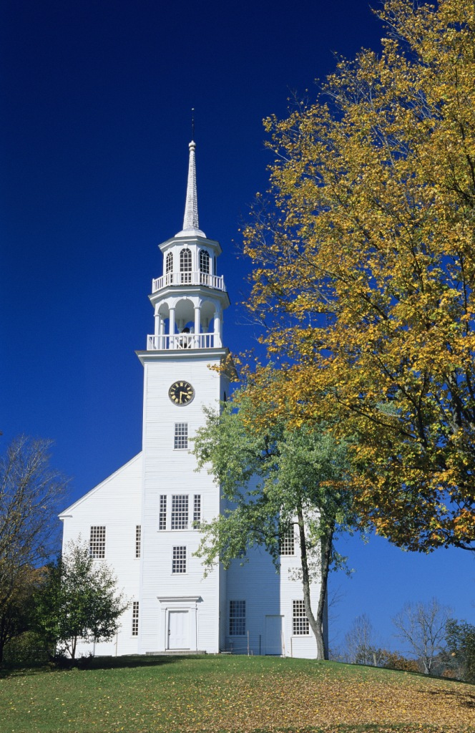

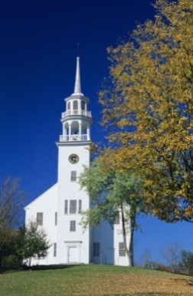
Prospect List Goals
Large
1 per member
Small to Medium
200-500

Slide 5
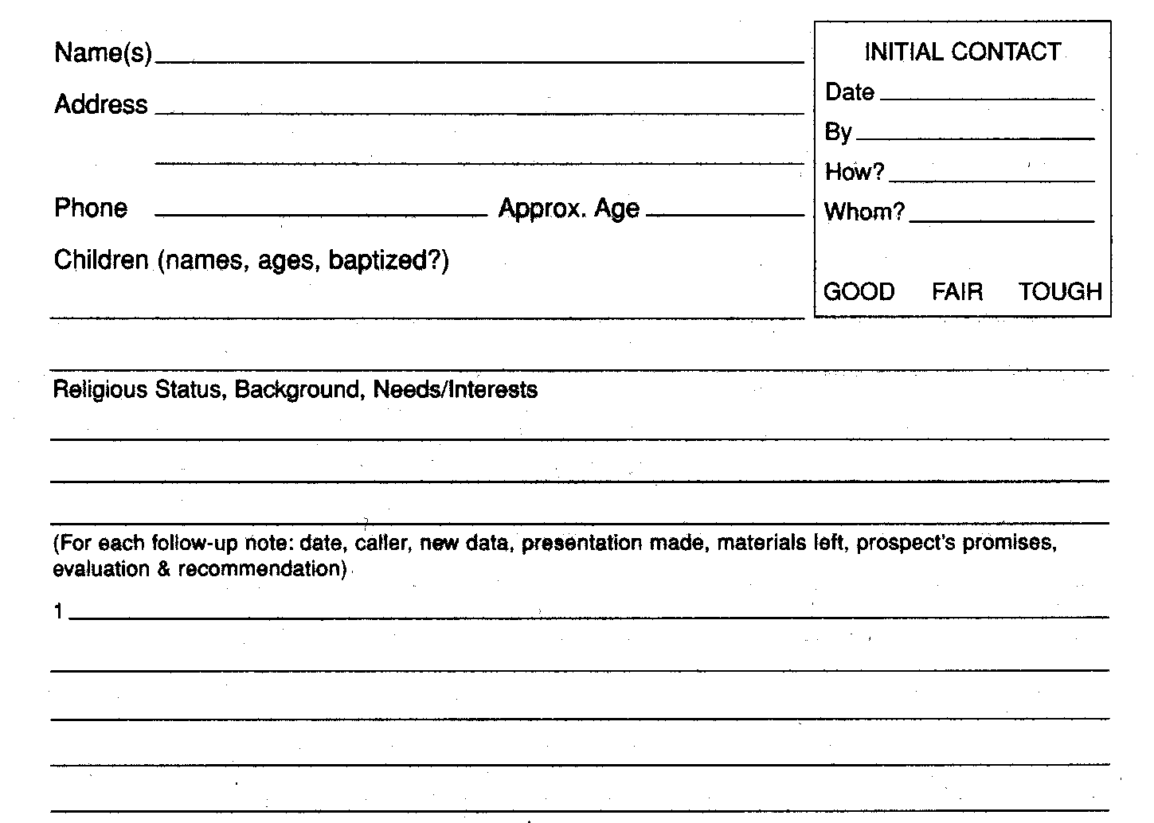
Prospect List Management
Paper

Slide 6
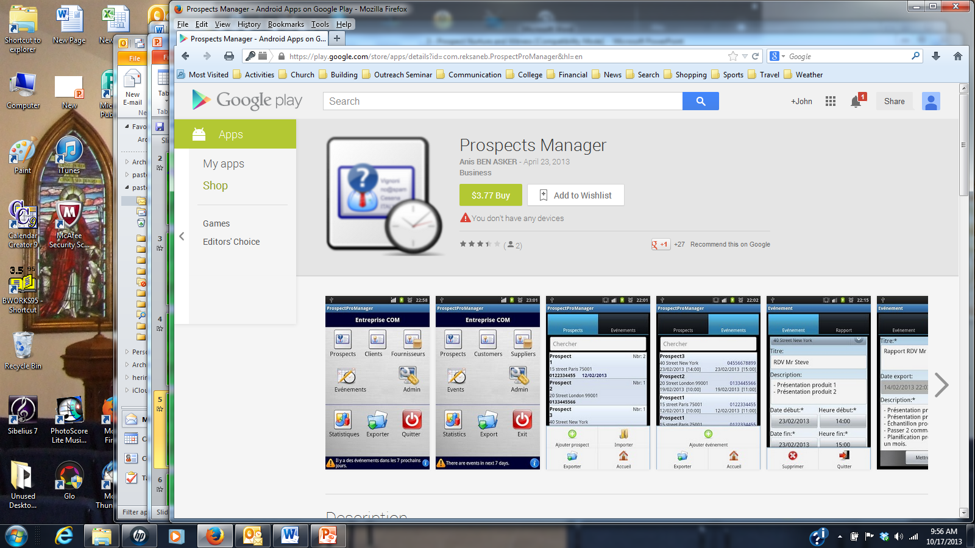
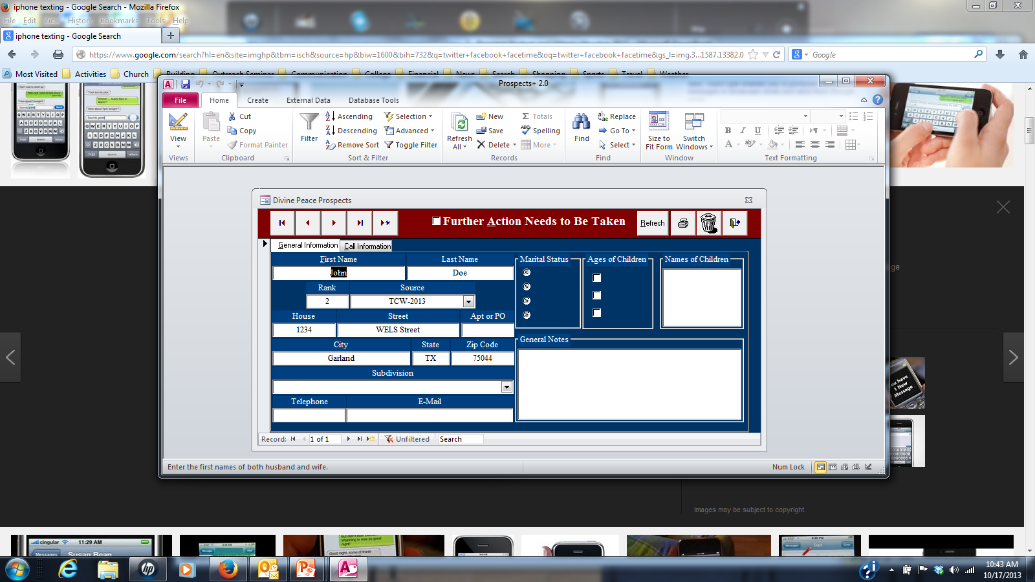

Prospect List Management
Software

Slide 7


Prospect List Manager
Gathers information
Keeps list current
Sorts list
Provides info as needed

Slide 8

“Prospect List” 200-500+
20-50 “Hot Prospects”
Follow –up Contacts …

Slide 9
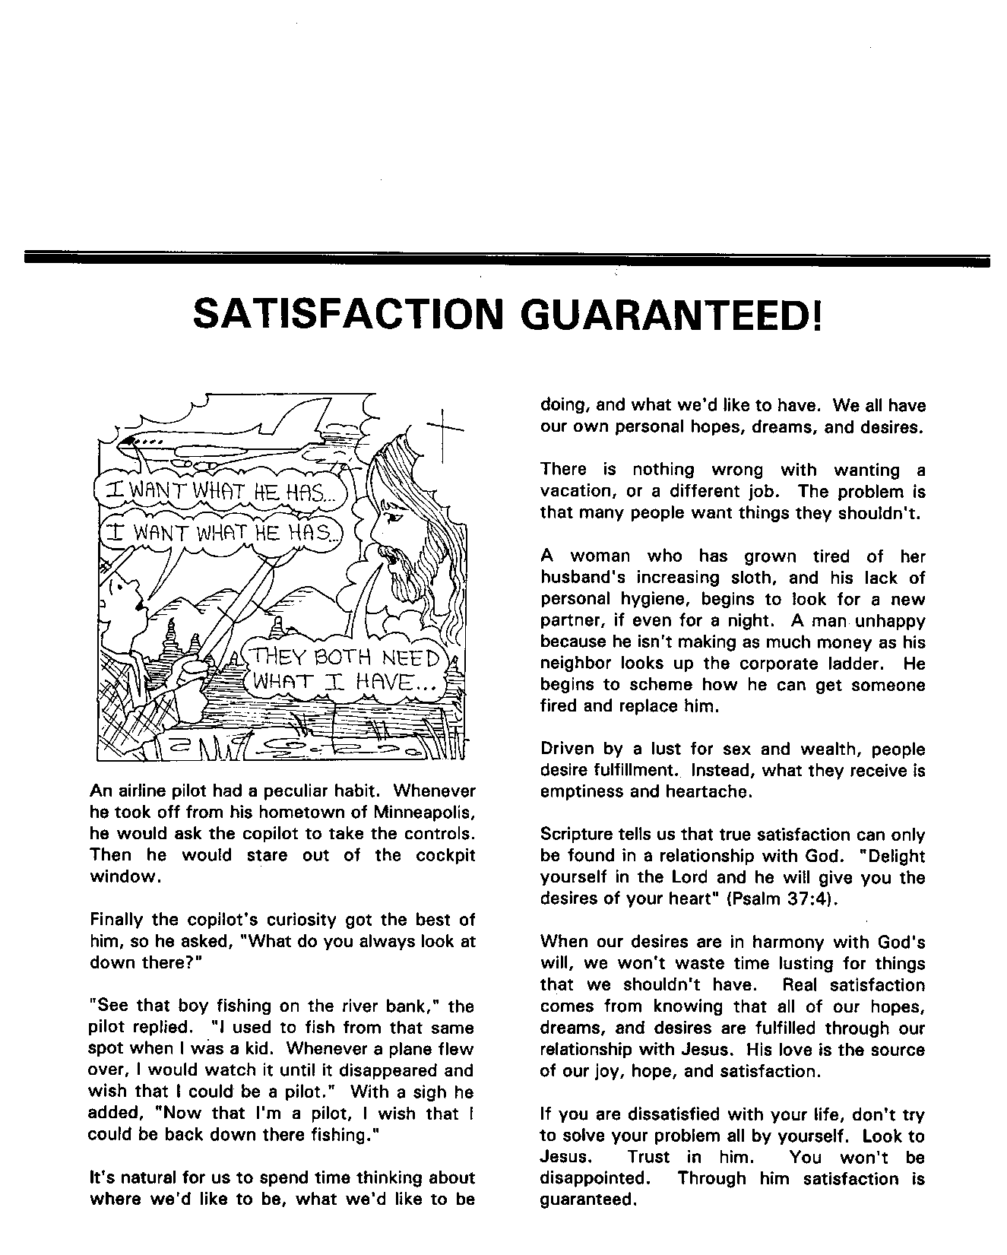
Outreach
Newsletter
Prepared by the Commission on Evangelism
One article a month
Written for the unchurched
One way to nurture those on the church’s prospect list

Slide 10
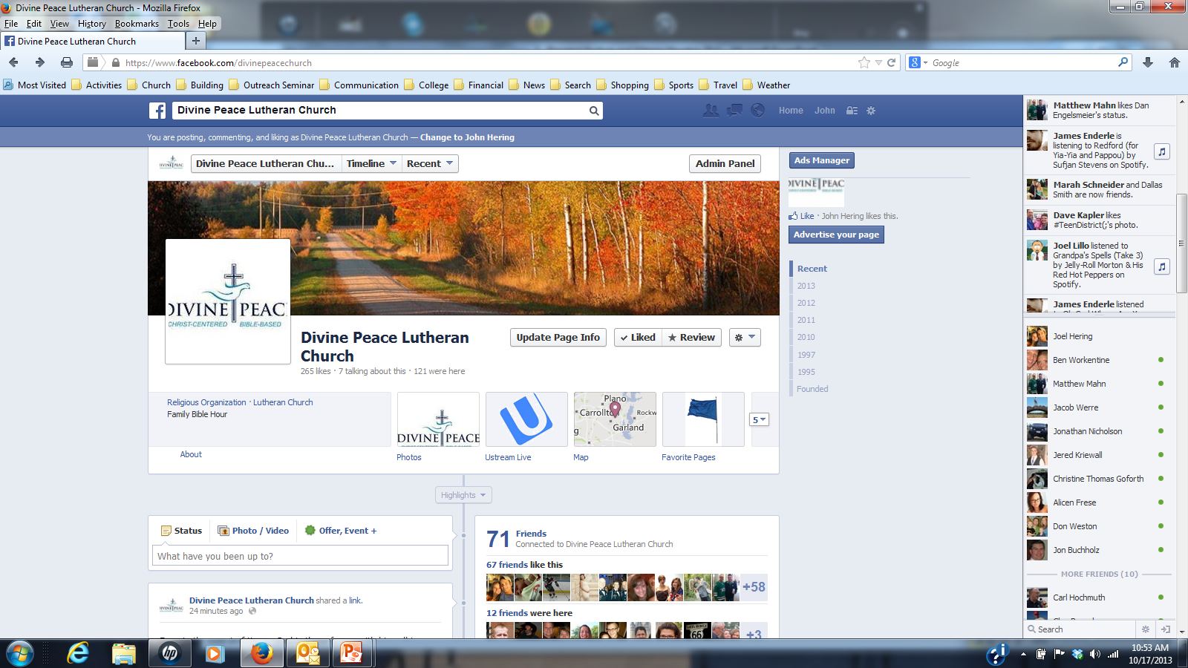
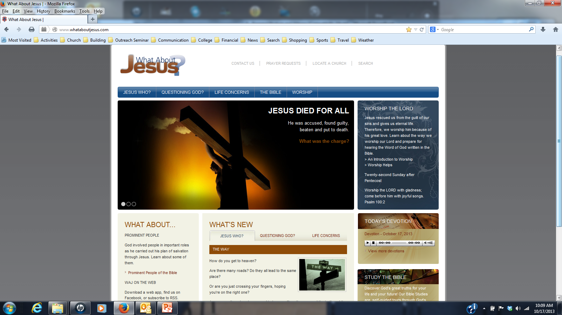
Daily Devotion
www.WhatAboutJesus.com

Slide 11


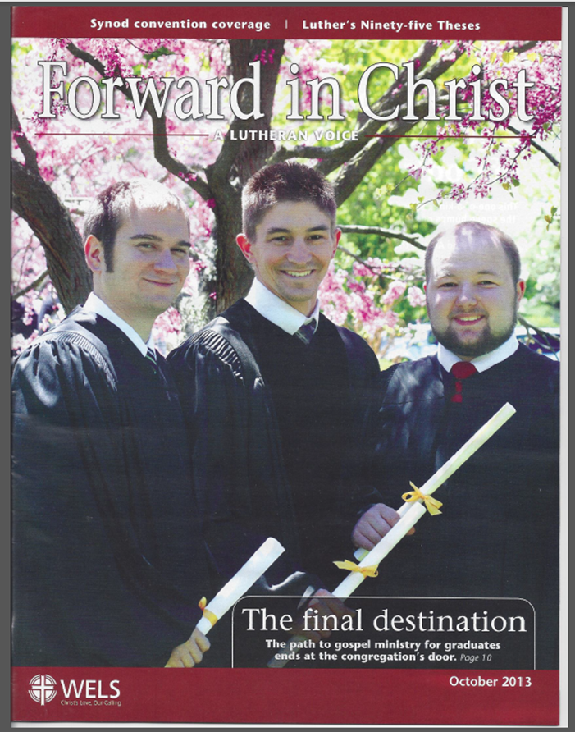



Brochures for Hand-outs, Mailings, Personal Witnessing
Visitation Program

Slide 12
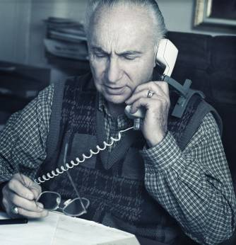


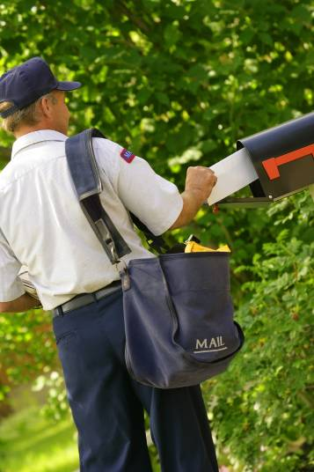

Personal Invitation

Slide 13

SHARE
THE WORD

Slide 14
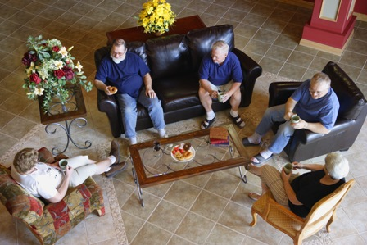
Witness Training
One trained witness
for
2 - 4 prospects

Slide 15
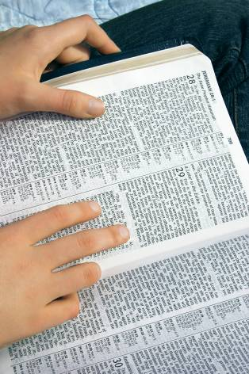
Isaiah 55:10-11
……..so is my word that goes out from my mouth: It will not return to me empty, but will accomplish what I desire and achieve the purpose for which I sent it.

Slide 16
2 Corinthians 2:14-17
For we are to God the aroma of Christ among those who are being saved and those who are perishing. To the one we are the smell of death; to the other, the fragrance of life.

Slide 17
Witness Training
God’s Great Exchange

Slide 18
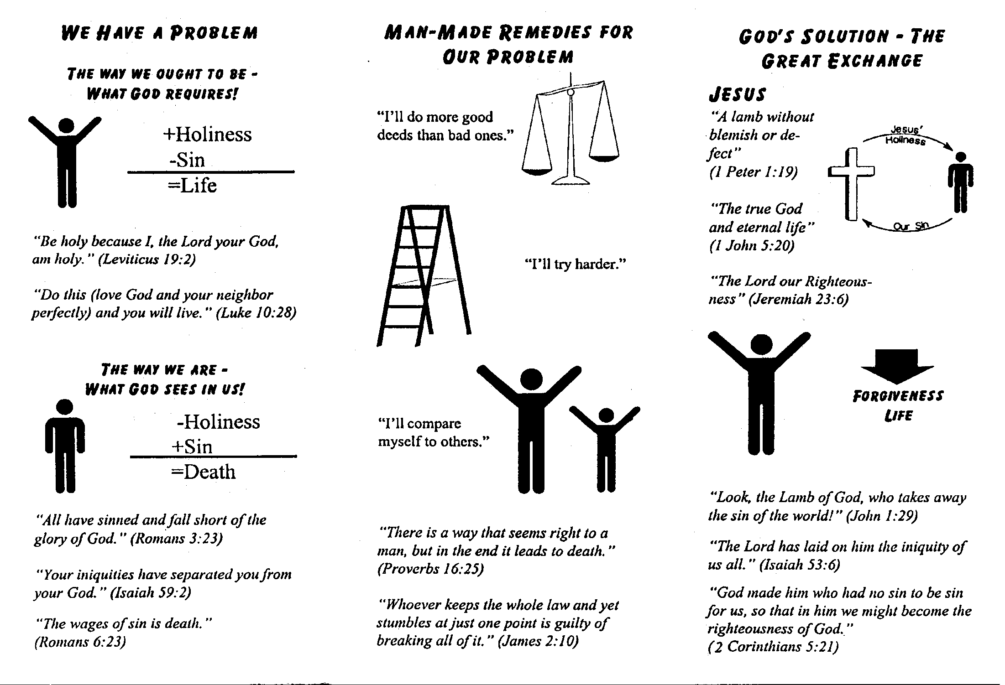

Slide 19

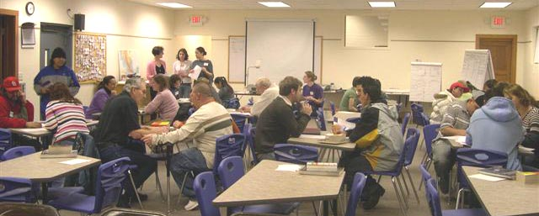
Classroom Training

Slide 20
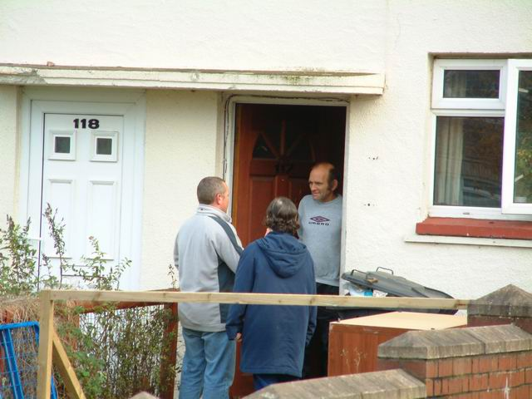
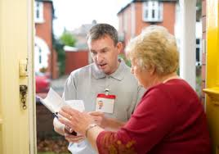
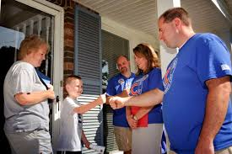
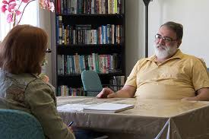
Actual Visits

Slide 21

Training Model
I do - You watch
I do - You help
You do - I help
You do - I watch
You & I - Take someone else

Slide 22

Make it your own!
I prefer the “Let me read the Bible to ya” approach!

Slide 23
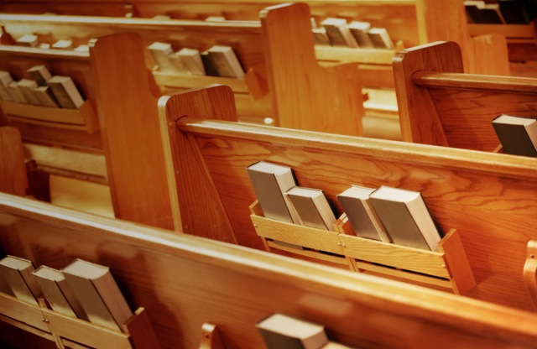
Worship Service Guests
Follow-up

Slide 24

Handwritten note

Slide 25
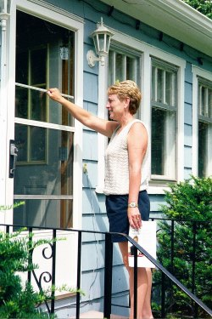
Visit

Slide 26



Pastor contact

Slide 27
2. Continue Visitation
Gain Trust
“Hot Prospects” -- monthly

Slide 28
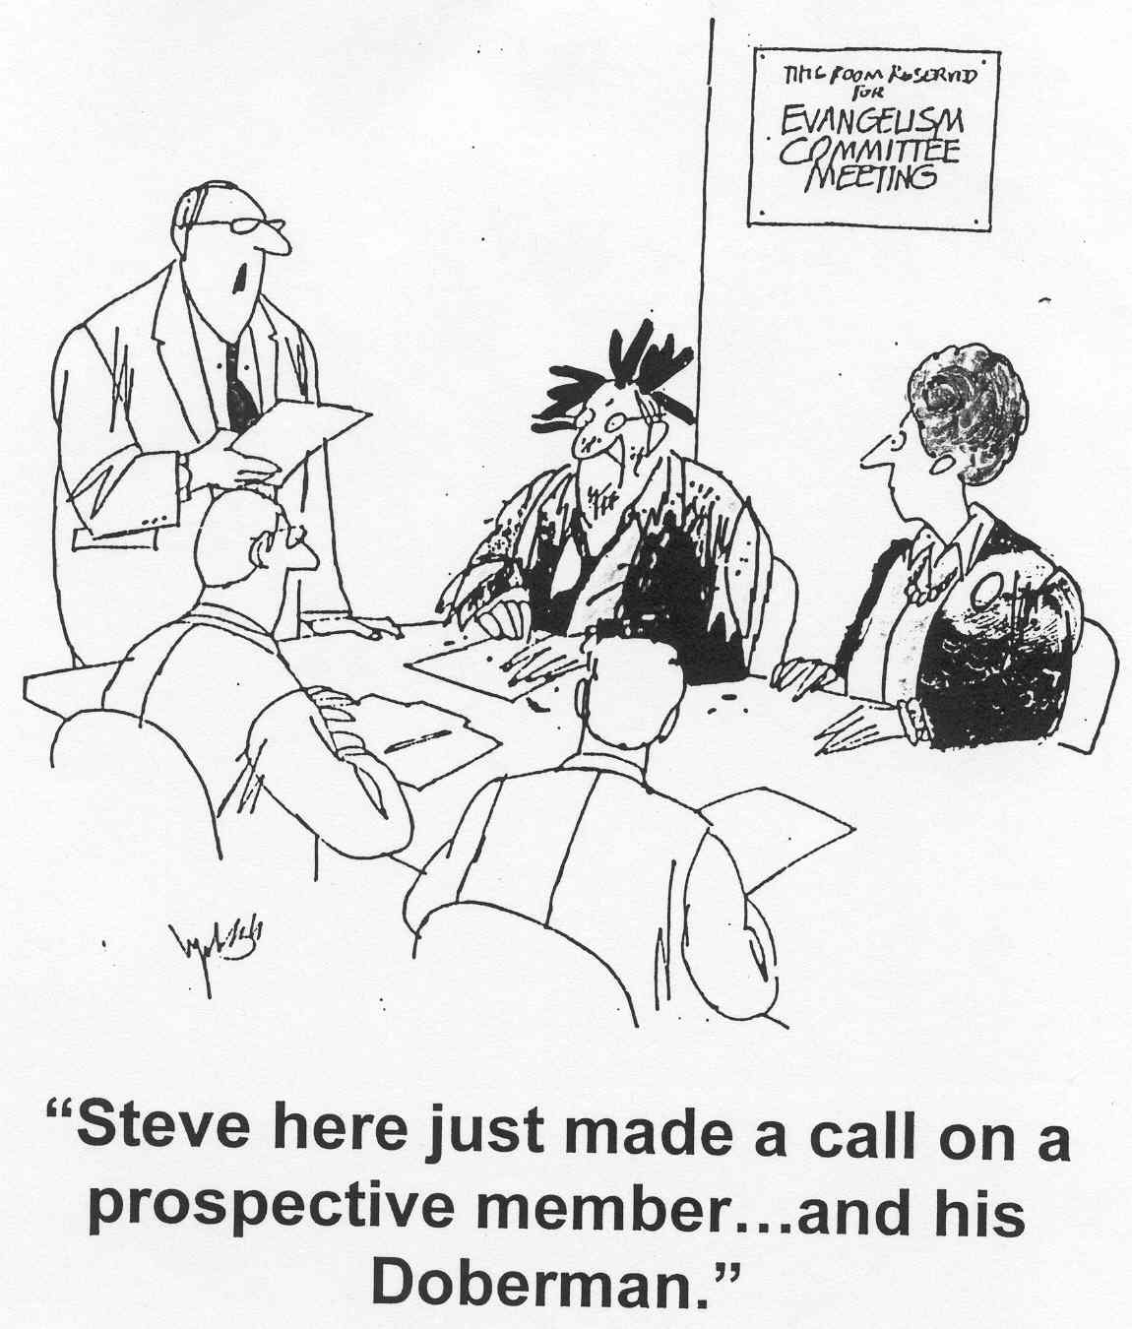

Slide 29

2. Continue Visitation
Gain Trust
“Hot Prospects” -- monthly
Various Approaches
Bible Stories
Bible Teachings
BIC Classes

Slide 30

Prayer team

Slide 31

3. Visitation Goals
Lead to God’s Word

Slide 32
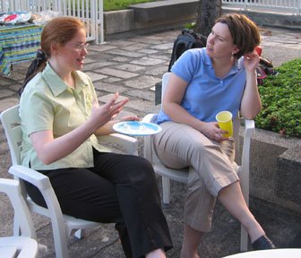



Just be a FRIEND!!

Slide 33
Nurturing Prospects
Huddle Group on page 32

Slide 34
Prospect Nurture and Witness

